Slide 1
Genes, Chromosomes, Alleles and Mutations

Slide 2
Review of DNA
7.1.1
C
G
A
T
G
C

Slide 3
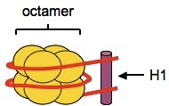
Nucleosomes
7.1.2 / 7.1.3
In eukaryotes, DNA associates with proteins called histones
DNA is wound around an octamer of histones and is secured to a H1 histone, forming a nucleosome
Nucleosomes serve two main functions:
  They protect DNA from damage
  They allow long lengths of DNA
  to be packaged (supercoiled)
  for mitosis / meiosis

Slide 4
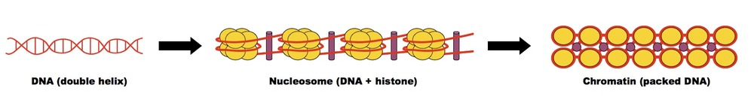
Eukaryotic Chromosomes
4.1.1
Eukaryotic chromosomes consist of DNA wrapped around histone proteins
This forms the basic structure of the nucleosome, which is packed together to form chromatin (in a 'beads on a string' arrangement)
Chromatin will supercoil and condense during prophase to form chromosomes

Slide 5
Key terms
4.1.2
Gene: A heritable factor that controls a specific characteristic, consisting of a length of DNA occupying a particular position on a chromosome (locus)
Allele: One specific form of a gene, differing from other alleles by one or a few bases only and occupying the same locus as other alleles of the gene
Genome: The whole of the genetic information of an organism

Slide 6
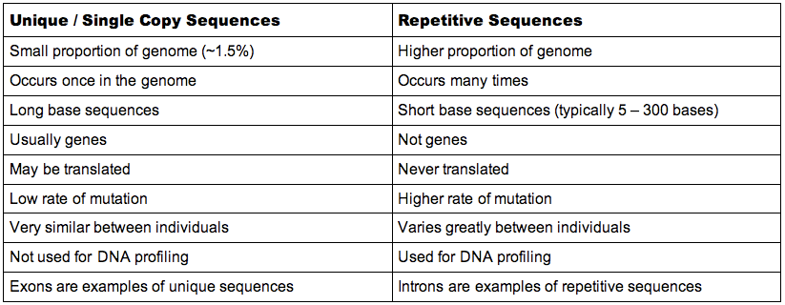
Composition of the Genome
7.1.4
DNA is either made up of unique sequences (genes) or non-coding sequences (which includes repetitive sequences)

Slide 7
Mutations!
4.1.3
Gene mutation: A change in the nucleotide sequence of a section of DNA coding for a particular feature
An example of a gene mutation that causes disease by altering the amino acid sequence of a polypeptide is sickle cell anaemia

Slide 8
Cause of Sickle Cell Anaemia
4.1.4
A base substitution mutation is the change of a single base in a sequence of DNA, resulting in a change to a single mRNA codon during transcription
In sickle cell anaemia, the 6th codon for the beta chain of haemoglobin is changed from GAG to GTG (on the non-coding strand)
This causes a change in the mRNA codon (GAG to GUG), resulting in a single amino acid change of glutamic acid to valine (Glu to Val)
The amino acid change alters the structure of haemoglobin, causing it to form fibrous, insoluble strands

Slide 9
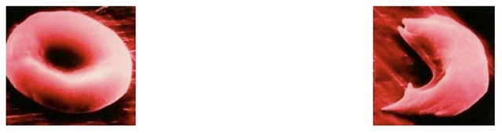
Red Blood Cells

Slide 10
Consequences of Sickle Cell Anaemia
The insoluble haemoglobin cannot effectively carry oxygen, causing individual to feel constantly tired
The sickle cells may accumulate in the capillaries and form clots, blocking blood supply to vital organs and causing a myriad of health problems
Also causes anaemia (low RBC count), as the sickle cells are destroyed more rapidly than normal red blood cells
Sickle cell anaemia is an autosomal recessive condition and is thus caused by having two recessive alleles
Heterozygous individuals have increased resistance to malaria due to the presence of a single recessive allele (heterozygous advantage)

Slide 11
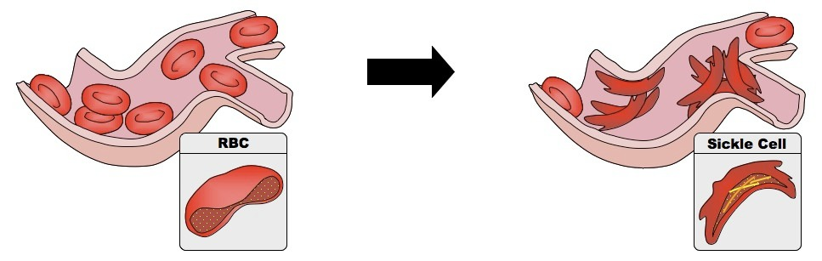
Anaemia

